Slide 1
ABC Call Volume Trend Analysis
Rajat Panwan

Slide 2
Project Description
The project is about analyzing the Customer Experience (CX) Inbound calling team dataset for 23 days. The dataset includes various parameters such as Agent_Name, Agent_ID, Queue_Time, Time, Time_Bucket, Duration, Call_Seconds, and Call status. The goal of the project is to analyze the data and find insights that can help improve the customer experience and optimize the performance of the inbound calling team.

Slide 3
Approach
My approach towards the project was to first understand the dataset and identify the key metrics that can provide insights into the performance of the inbound calling team. I then used various data analysis and visualization techniques to analyze the data and find patterns and trends. Finally, I summarized my findings and provided recommendations to improve the customer experience.

Slide 4
Tech-Stack Used
The analysis was performed using Microsoft Excel. I used different Excel functions, such as COUNT, COUNTIFS, SUM, UNIQUE and AVERAGE to perform the analysis. I also used PIVOT TABLE, SLICER in Pivot Table, CHARTS and GRAPHS to visualize the data.

Slide 5
Insights
Call duration in the morning and also evening is higher as compare to the noon. I would suggest that company should try to decrease the call duration by giving agents proper training. This is how we can decrease the call abandance.
12 pm -1 pm is the busiest time. Infect between 10 am to 3 pm more than 50% of the call valume is received. For this reason we should hire agents for the 10 am to 3 pm.
If the agents are working 5 hours a week and take 4 leaves in a month, 93 agents a required.
A total of 30 agents are required for the night calls to answer the 90% of the calls.

Slide 6
Result
The project helped us gain insights into the performance of the inbound calling team and the customer experience. I was able to identify the key metrics that impact the customer experience and provide recommendations to optimize the performance of the inbound calling team. The project also helped us develop my data analysis and visualization skills and provided us with hands-on experience in machine learning. What I have get is on next pages.

Slide 7
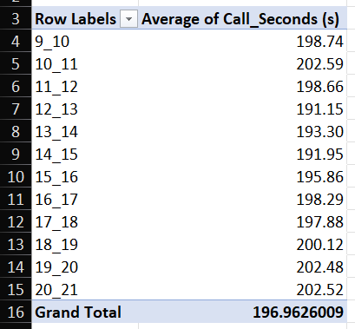
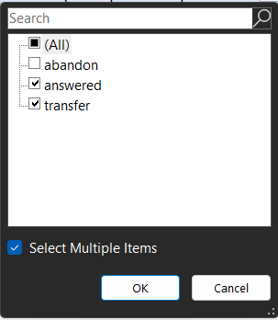

A. Calculate the average call time duration for all incoming calls received by agents (in each Time_Bucket)
Here pivot table is used to get the average call received, in the pivot “Time_Bucket” is used as a row and Average value of “Call_Seconds” is used as values. This pivot table includes the counts of the abandon calls also to filter it out “Call_Status” is used as filter.

Slide 8
A. Calculate the average call time duration for all incoming calls received by agents (in each Time_Bucket)
Based on the available data we can say that call duration in the morning and in the evening is higher as compare to the noon. I would suggest that company should try to decrease the call duration by giving agents proper training. This is how they can call abandoned numbers.

Slide 9
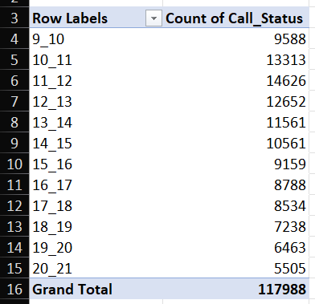
B. Show the total volume/ number of calls coming in via charts/ graphs [Number of calls v/s Time]. You can select time in a bucket form.
Here pivot table is used to get the count of the Call_Status. In the pivot table Time_Bucket is used as rows and Count of the Call_Status is used as a value.
Based on the available data we can say that 12-13 hours is the busiest time. Between 10 am to 3 pm more than 50% of the calls are received. I would suggest that almost 50 % of the work force should be hired for the 10 am to 3 pm

Slide 10
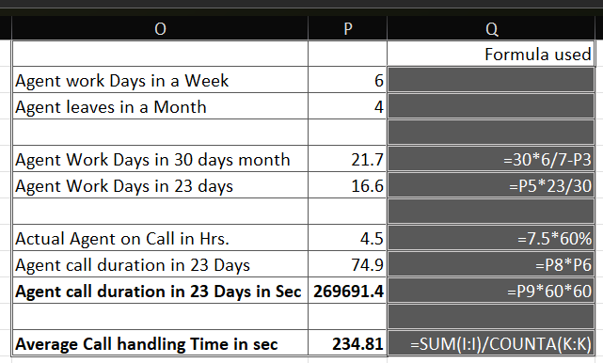
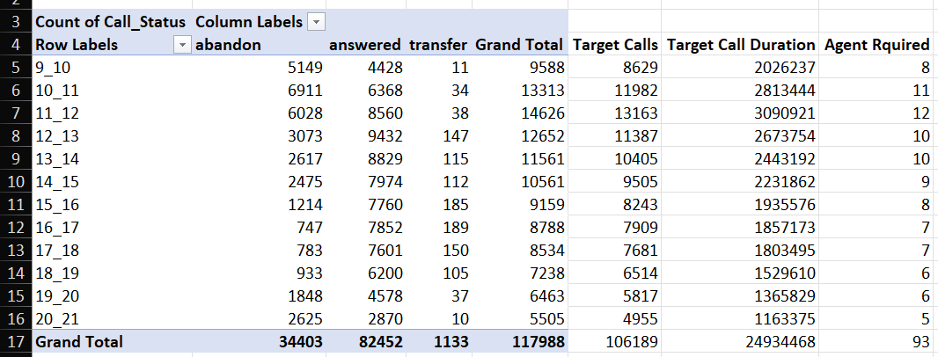



C. As you can see current abandon rate is approximately 30%. Propose a manpower plan required during each time bucket [between 9am to 9pm] to reduce the abandon rate to 10%.
In the right side of table pivot table is used with count Call_Status as value and Bucket as rows. Adjacent formulae is used respectively to calculate Target call which is 90% of the total call received, Target call duration and Agent Required. Left side of table is used to calculate Agent call duration in 23 Days and Average call handling time in sec.

Slide 11
C. As you can see current abandon rate is approximately 30%. Propose a manpower plan required during each time bucket [between 9am to 9pm] to reduce the abandon rate to 10%.
Based on the data available we can say that at least 12 agents are required in the time bracket 11am to 12 pm. If the agents are working 5 hours a week and take 4 leaves in a month also because data given here is for 23 days so for 30 days time span 93 agents a required.

Slide 12

D. Let’s say customers also call this ABC insurance company in night but didn’t get answer as there are no agents to answer, this creates a bad customer experience for this Insurance company. Suppose every 100 calls that customer made during 9 Am to 9 Pm, customer also made 30 calls in night between interval [9 Pm to 9 Am]
Count of Call_Status | Column Labels
Row Labels | abandon | Answered | transfer | Grand Total
9_10 | 5149 | 4428 | 11 | 9588
10_11 | 6911 | 6368 | 34 | 13313
11_12 | 6028 | 8560 | 38 | 14626
12_13 | 3073 | 9432 | 147 | 12652
13_14 | 2617 | 8829 | 115 | 11561
14_15 | 2475 | 7974 | 112 | 10561
15_16 | 1214 | 7760 | 185 | 9159
16_17 | 747 | 7852 | 189 | 8788
17_18 | 783 | 7601 | 150 | 8534
18_19 | 933 | 6200 | 105 | 7238
19_20 | 1848 | 4578 | 37 | 6463
20_21 | 2625 | 2870 | 10 | 5505
Grand Total | 34403 | 82452 | 1133 | 117988
Time_Bucket_night | Ratio | Call_Counts | Average_call_Duration | Round off Agent Required | Ceiling Value of Agent Required
9pm-10pm | 3 | 3539.64 | 831148.94 | 3 | 4
10pm-11pm | 3 | 3539.64 | 831148.94 | 3 | 4
11pm-12am | 2 | 2359.76 | 554099.29 | 2 | 3
12am-1am | 2 | 2359.76 | 554099.29 | 2 | 3
1am-2am | 1 | 1179.88 | 277049.65 | 1 | 2
2am-3am | 1 | 1179.88 | 277049.65 | 1 | 2
3am-4am | 1 | 1179.88 | 277049.65 | 1 | 2
4am-5am | 1 | 1179.88 | 277049.65 | 1 | 2
5am-6am | 3 | 3539.64 | 831148.94 | 3 | 4
6am-7am | 4 | 4719.52 | 1108198.59 | 4 | 5
7am-8am | 4 | 4719.52 | 1108198.59 | 4 | 5
8am-9am | 5 | 5899.40 | 1385248.23 | 5 | 6
Grand Total | 30 | 35396.4 | 8311489.408 | 30 | 42
In the left side of the table pivot table function is used to get grand total of the call received which is 117988. Above formula is used to get 30% of the total calls which is 35396 because 30% calls are received at night. Then 35396 is divided into different time bucket according to the ratio given.

Slide 13




D. Let’s say customers also call this ABC insurance company in night but didn’t get answer as there are no agents to answer, this creates a bad customer experience for this Insurance company. Suppose every 100 calls that customer made during 9 Am to 9 Pm, customer also made 30 calls in night between interval [9 Pm to 9 Am]
Based on the available data we can say that total 30 agents are required when Round() function is used. But I think Ceiling.math() function is more appropriate here because minimum number of call acceptance is 90% when we use round() function I could be possible that abandon call could be more than 10% so 42 should be the number for maintaining 90% call should be answered at every time bucket.

Slide 14
Drive Link
Workbook link

Slide 15
Thank You
Rajat Panwan
rajatpawan@gmail.com
Mb. 9457941019

